Slide 1
API SYSTEMS
For MLOPS Marathon
Team: BKT

Slide 2
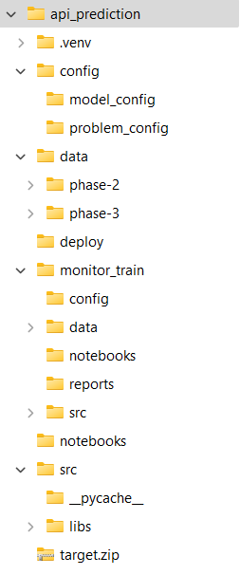
Code Structure

Slide 3
Architecture of API system

Slide 4
Framework Selection
API Frameworks selection:
Falcon
FastAPI
BlackSheep
ASGI Server selection:
Uvicorn (Default ASGI server for FastAPI)
Hypercorn (ASGI server with HTTP/2 support)
Granian (Written in Rust)
Nginx Unit (Universal Web App Server – support python)
A bash script is used for switch between server and framework using Command line arguments.

Slide 5
Model and Optimize
Use lgbm and xgb (set by model config file)
Improve inference time by compiling model to binary: lleaves for Lightgbm and Treelite for XgBoost: set by using environment variables
Using additional dataset: UNSW-NB15, NSL-KDD, KDD-CUP
Hyperparameter tuning:
FLAML Library
Optuna
GridSearchCV
HyperOpt
Notes:
Other can be used for model inference: ONNX Runner, Daal4Py (by intel)
Some Libraries can be used for optimize model:
- Pycaret: Comparison difference models
- Featurewiz: For feature selection
- CleanLab: Help to fix label issues
- Using PU or Semi-supervised learning techniques.

Slide 6
Training
Model is trained in Notebook and Tracked by using Mlflow (on server).

Slide 7

Monitoring

Slide 8
Deployment

